Slide 1


SAVEETHA SCHOOL OF ENGINEERING
SAVEETHA INSTITUTE OF MEDICAL AND TECHNICAL SCIENCES
COURSE CODE: 1590
CSA1590 CLOUD COMPUTING FOR BIG DATA ANLYTICS FOR VIRTUAL CLUSTERS
TOPIC:
Transforming Tomorrow: Crafting the Future of Automated Software Defined Data Center Management
FACULTY NAME: Dr.Gnana Soundari
By,
NAME : Manoj Kumar
REG.NO: 192224197

Slide 2


Transforming Tomorrow: Crafting the Future of Automated Software Defined Data Center Management

Slide 3
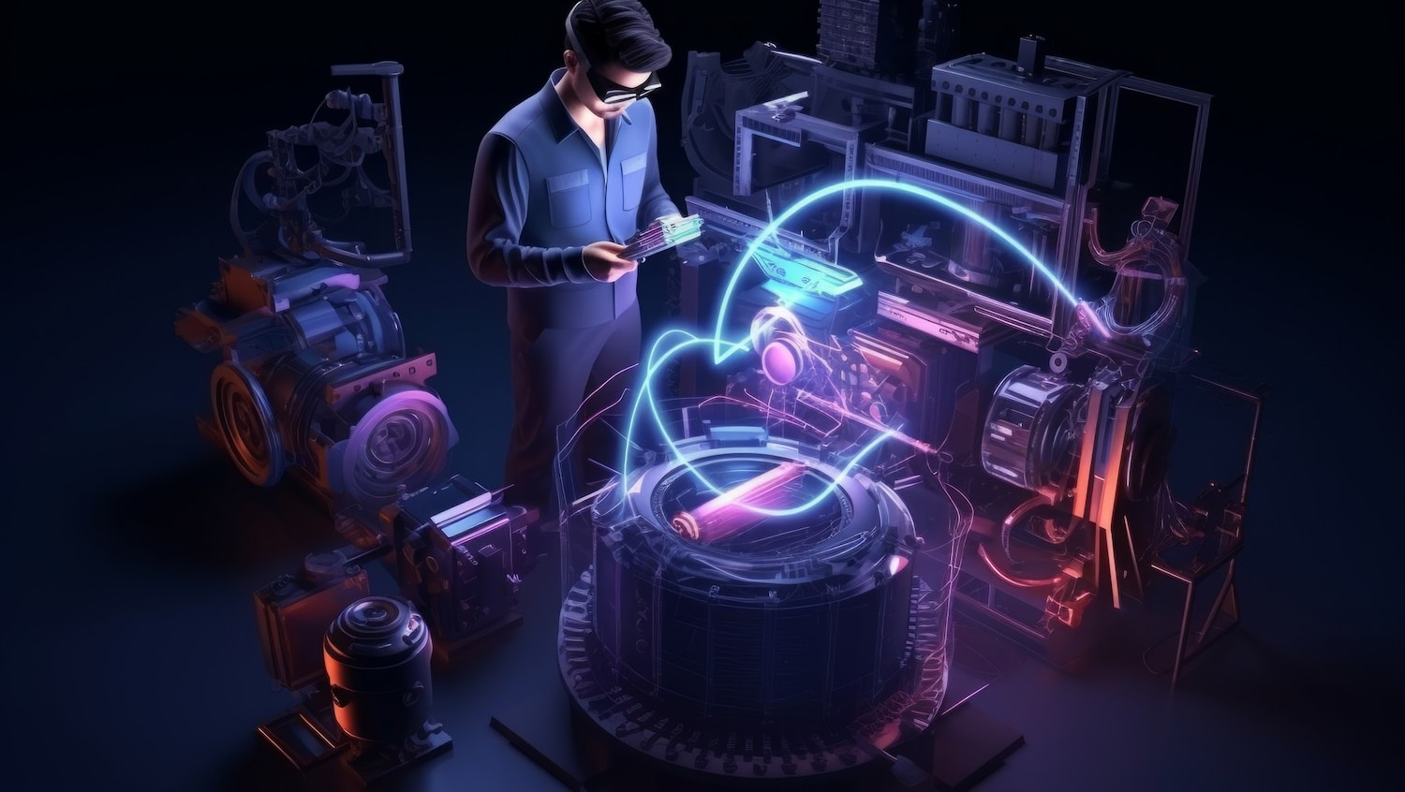
Introduction to Automated Data Centers
In today's world, automated software-deﬁned data centers are revolutionizing how businesses operate. This presentation explores the innovative technologies and strategies that will shape the future of data center management, enhancing eﬃciency and scalability.

Slide 4
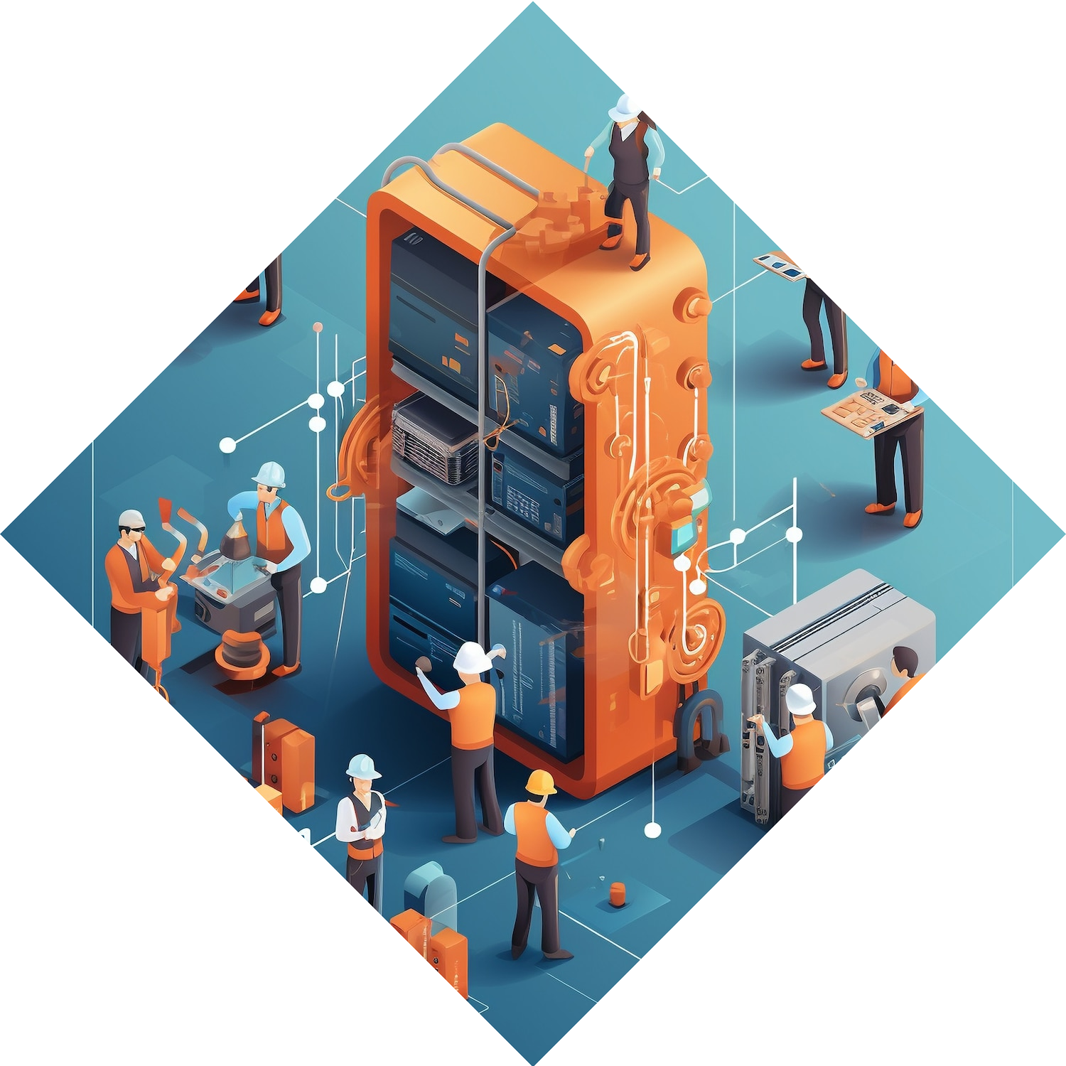
Understanding Software Defined
Data Centers
A Software Deﬁned Data Center (SDDC) abstracts and automates the physical resources of a data center.
This allows for greater ﬂexibility,
resource optimization, and cost reduction. Understanding its core components is essential for eﬀective
management.

Slide 5
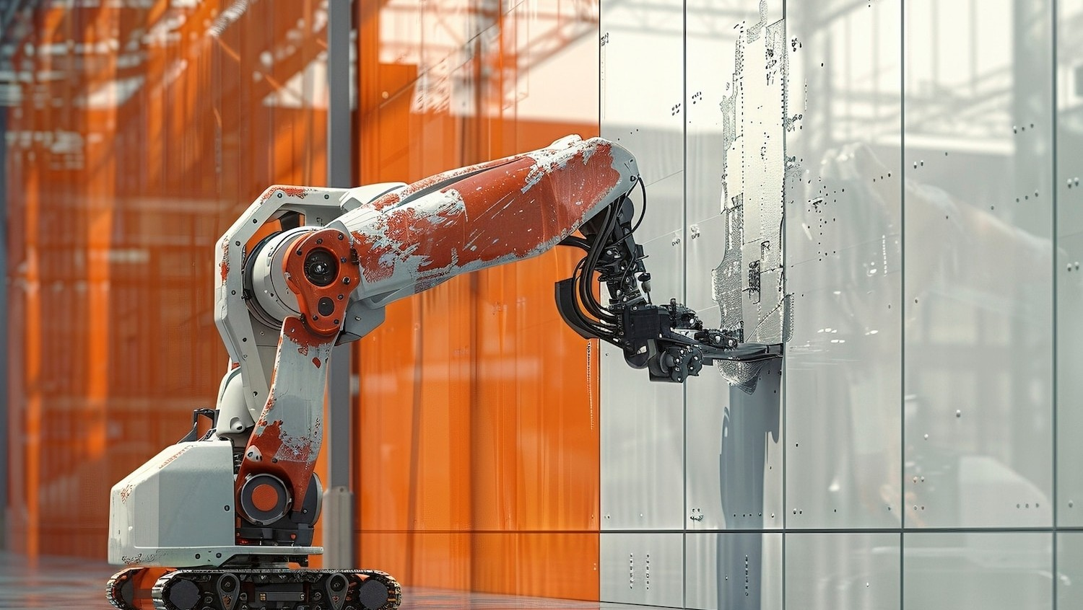
The Role of Automation
Automation is pivotal in SDDC management. By leveraging AI and machine learning, organizations can streamline operations, reduce human error, and enhance service delivery.
This leads to a more responsive and
agile IT environment.

Slide 6

Key Benefits of SDDC Management
The transition to SDDC management oﬀers numerous beneﬁts: improved resource utilization, enhanced scalability, and better disaster recovery options. These advantages enable organizations to adapt quickly to changing business needs.

Slide 7

Challenges in Implementation
While SDDC oﬀers many advantages, challenges such as integration issues, security concerns, and the need for skilled personnel can arise.
Addressing these challenges is crucial for successful implementation and
ongoing management.

Slide 8

Future Trends in Data Center Management
Emerging trends such as edge computing, serverless architectures, and enhanced security protocols will shape the future of data centers.
Staying ahead of these trends is essential for organizations aiming for
competitive advantage.

Slide 9

Case Studies of Success
Real-world examples demonstrate the eﬀectiveness of SDDC management.
Companies that have adopted these
practices report signiﬁcant improvements
in operational eﬃciency, cost savings, and customer satisfaction. Learning from these cases can guide future strategies.

Slide 10
Conclusion: Crafting the Future
Transforming tomorrow requires embracing automated software-deﬁned data center management. By leveraging the latest technologies and overcoming challenges, organizations can build a more eﬃcient, scalable, and resilient infrastructure for the future.

Slide 11
Thanks!

